Slide 1



MPIG Open Seminar 00106
Large Scale Machine Learning
袁洪慧
Machine Perception and Interaction Group (MPIG)
www.mpig.com.cn
yhh@mpig.com.cn
公众号:
mpig_robot

Slide 2
Learning
With
Large Datasets

Slide 3
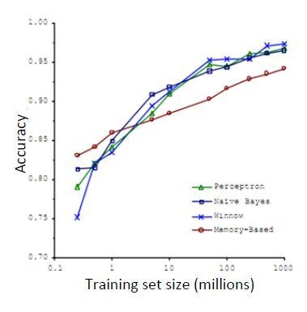
Machine learning and data
Classify between confusable words.
E.g., {to , two, too }, { then, than}.
For breakfast I ate _______ eggs.
“It’s not who has the best algorithm that wins.
It’s who has the most data.”

Slide 4
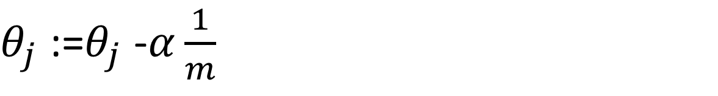
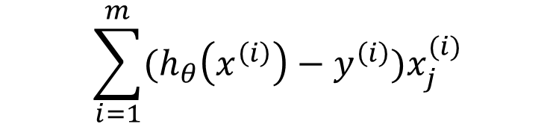
Learning with large datasets
$$\sum_{i=1}^{m}{(h_{θ}\left(x^{\left(i\right)}\right)−y^{\left(i\right)})x_{j}^{(i)}}$$
$θ_{j}$ :=$θ_{j}$ -$α\frac{1}{m}$
error
error
m (training set size)
m (training set size)

Slide 5
Stochastic
Gradient Descent

Slide 6
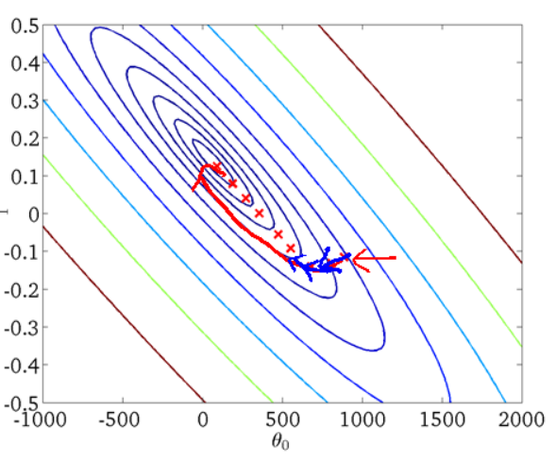

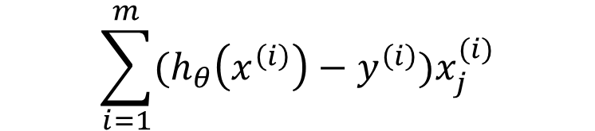
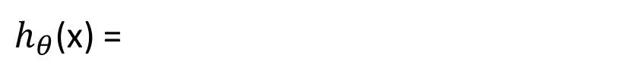
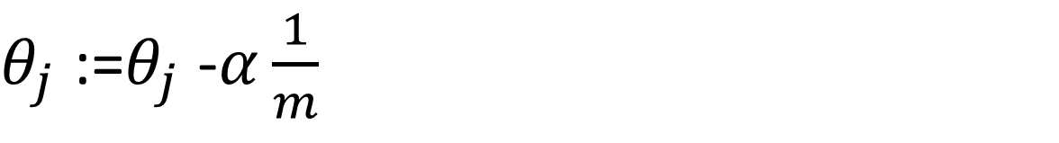
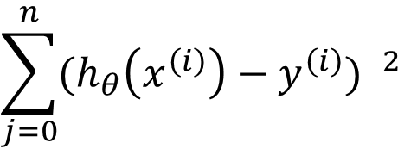
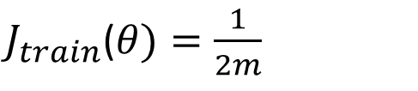
Linear regression with gradient descent
$$\sum_{j=0}^{n}{θ_{j}x_{j}}$$
p2
$h_{θ}$(x) =
$$\sum_{j=0}^{n}{{(h_{θ}\left(x^{\left(i\right)}\right)−y^{\left(i\right)}) }^{2}}$$
$J_{train}$($θ)=\frac{1}{2m}$
Repeat{
(for every j =0,……,n)
}
$$\sum_{i=1}^{m}{(h_{θ}\left(x^{\left(i\right)}\right)−y^{\left(i\right)})x_{j}^{(i)}}$$
$θ_{j}$ :=$θ_{j}$ -$α\frac{1}{m}$

Slide 7
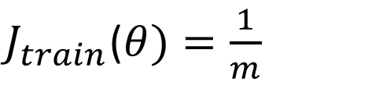
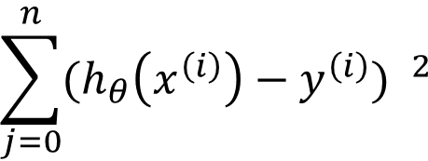

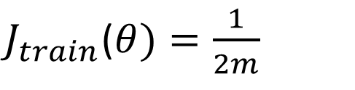
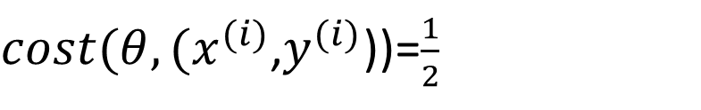
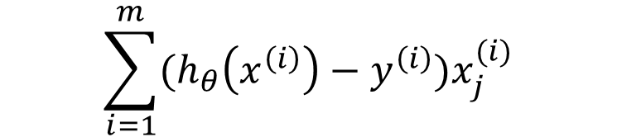
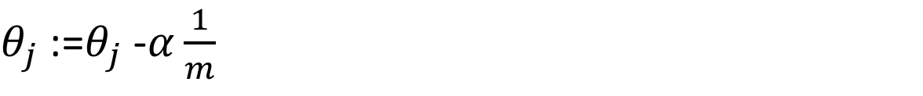
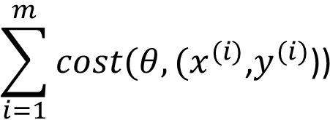
Batch gradient descent
Stochastic gradient descent
$$\sum_{j=0}^{n}{{(h_{θ}\left(x^{\left(i\right)}\right)−y^{\left(i\right)}) }^{2}}$$
$J_{train}$($θ)=\frac{1}{2m}$
$${(h_{θ}\left(x^{\left(i\right)}\right)−y^{\left(i\right)})}^{2}$$
$cost(θ,(x^{(i)}$,$y^{(i)}$))=$\frac{1}{2}$
Repeat{
(for every j =0,……,n)
}
$$\sum_{i=1}^{m}{cost(θ,(x^{(i)}\text{,}y^{(i)}\text{))}}$$
$J_{train}$($θ)=\frac{1}{m}$
$$\sum_{i=1}^{m}{(h_{θ}\left(x^{\left(i\right)}\right)−y^{\left(i\right)})x_{j}^{(i)}}$$
$θ_{j}$ :=$θ_{j}$ -$α\frac{1}{m}$
p59
p58

Slide 8
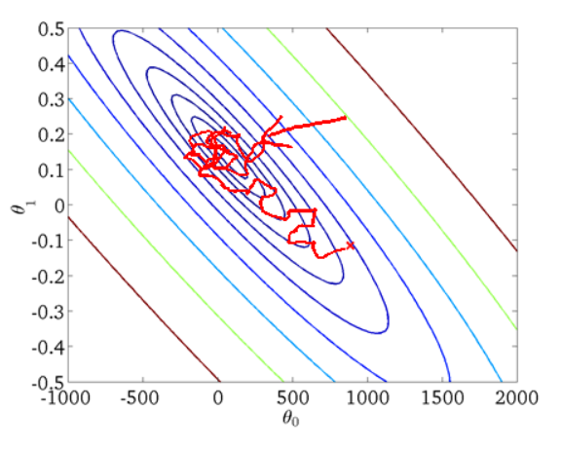
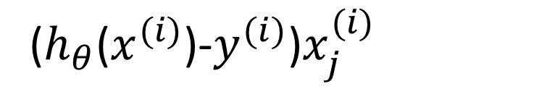
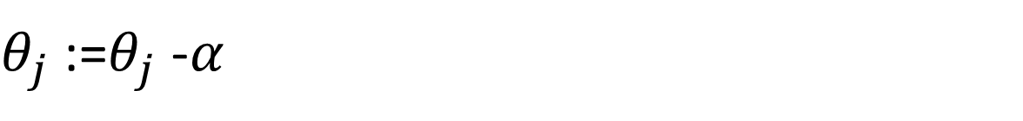
Stochastic gradient descent
1.Randomly shuffle (reorder) training examples
2.Repeat{
for i:=1,……m {
( for every j=0,……n)
} }
($h_{θ}$($x^{(i)}$)-$y^{(i)}$)$x_{j}^{(i)}$
$θ_{j}$ :=$θ_{j}$ -$α$

Slide 9
Batch gradient descent
Stochastic gradient descent
%A*theta = [19 26 19 20]';
A = [1 4;2 5;5 1;4 2];
theta = [2 5]';
result = [19 26 19 20]';
Learning _ rate = 0.01;
loss = 1000;
i = 0;
while ( I <=100&&loss>0.0001)
%error _ sum = 0;
i = i+1;
error = result-A*theta;
theta = theta + learning _ rate*A'*error;
fprintf(‘ theta now is %2.of\n',theta);
loss = (A*theta - result)'*(A*theta-result);
fprintf(‘ loss now is %f\ n‘ , loss);
end
A = [1 4;2 5;5 1;4 2];
theta = [2 5]';%int value
result = [19 26 19 20]';
Learning _ rate = 0.01;
loss = 1000;
i = 0;
error = zeros(4,1);
while ( i <= 100 && loss > 0.001 )
j = mod(i,4)+1;
error ( j,:) = result ( j, :)-A(j ,:)*theta;
theta = theta + learning _ rate.*A'*error;
fprintf (‘ theta now is %2.of\n',theta);
loss=(A*theta-result)'*(A*theta-result);
fprintf (‘ loss now is %f\n‘ , loss);
i=i+1;
end

Slide 10
Mini – Batch
Gradient Descent

Slide 11
Mini – batch gradient descent
“Bath”: Each step of gradient descent uses all the training examples.
“Stochastic”: Each step of gradient descent uses 1 training examples.
“Mini-Batch”: Each step of gradient descent uses b the training examples.

Slide 12
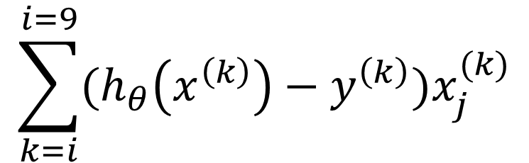
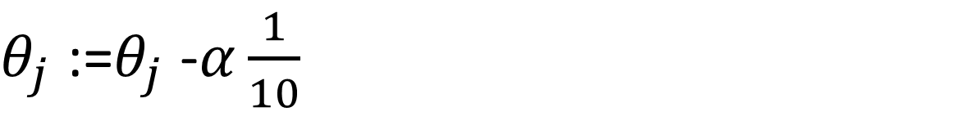
Mini – batch gradient descent
Say b=10,m=1000
Repeat{
for i = 1,11,21,31,……,991{
(for every j =0,…….n)
}
}
$$\sum_{k=i}^{i=9}{(h_{θ}\left(x^{\left(k\right)}\right)−y^{\left(k\right)})x_{j}^{(k)}}$$
$θ_{j}$ :=$θ_{j}$ -$α\frac{1}{10}$

Slide 13
Stochastic
Gradient Descent
Convergence

Slide 14
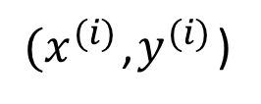
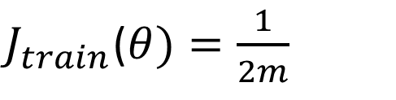
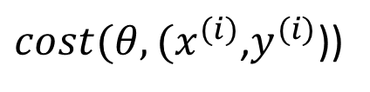
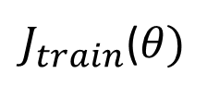

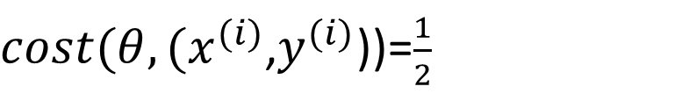
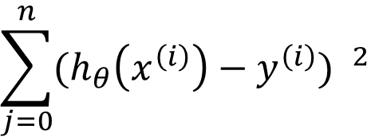
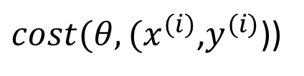
Checking for convergence
Batch gradient descent:
Plot as a function of the number of iterations of gradient descent.
$J_{train}$($θ)$
$J_{train}$($θ)=\frac{1}{2m}$
$$\sum_{j=0}^{n}{{(h_{θ}\left(x^{\left(i\right)}\right)−y^{\left(i\right)}) }^{2}}$$
Stochastic gradient descent:
$${(h_{θ}\left(x^{\left(i\right)}\right)−y^{\left(i\right)})}^{2}$$
$cost(θ,(x^{(i)}$,$y^{(i)}$))=$\frac{1}{2}$
During learning , compute before updating
$(x^{(i)}$,$y^{(i)}$)
$cost(θ,(x^{(i)}$,$y^{(i)}$))
Every 1000 iterations (say), plot averaged over the last 1000 examples processed by algorithm
$cost(θ,(x^{(i)}$,$y^{(i)}$))

Slide 15
Checking for convergence

Slide 16
Checking for convergence

Slide 17
Checking for convergence
红：5000
蓝：1000

Slide 18
Checking for convergence

Slide 19
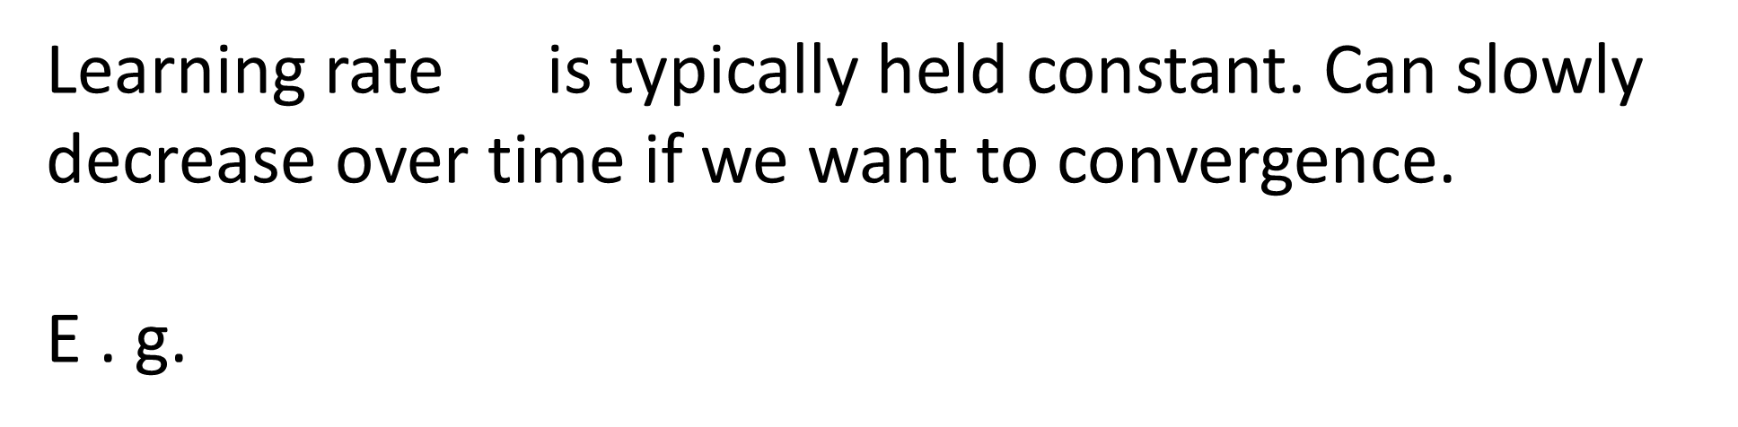
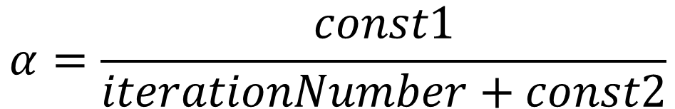

Stochastic gradient descent
$$α$$
$$α=\frac{const1}{iterationNumber+const2}$$

Slide 20

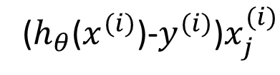
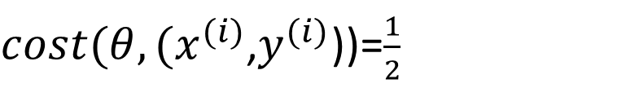
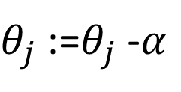
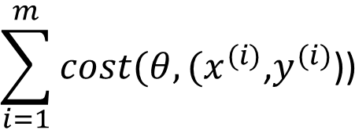
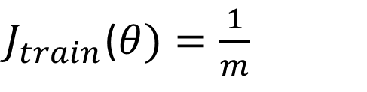
Stochastic gradient descent
$cost(θ,(x^{(i)}$,$y^{(i)}$))=$\frac{1}{2}$
$${(h_{θ}\left(x^{\left(i\right)}\right)−y^{\left(i\right)})}^{2}$$
$$\sum_{i=1}^{m}{cost(θ,(x^{(i)}\text{,}y^{(i)}\text{))}}$$
$J_{train}$($θ)=\frac{1}{m}$
Randomly shuffle dataset.
repeat{
for i := 1,……m {
(for j =0,…….n)
}
}
$θ_{j}$ :=$θ_{j}$ -$α$
($h_{θ}$($x^{(i)}$)-$y^{(i)}$)$x_{j}^{(i)}$

Slide 21
Online Learning

Slide 22
Online learning
Shipping service website where users comes, specifies origin and destination , you offer to ship their package for some asking price, and users sometimes choose to use you shipping service ( y =1),sometimes not ( y = 0 ).
Features:
capture properties of user , of origin / destination and asking price we want to learn p ( y =1/x; θ ) to optimize price.

Slide 23
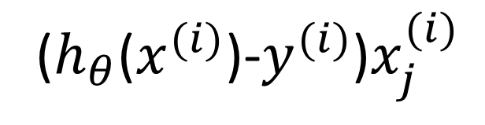
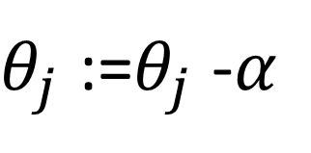
Online learning
Repeat forever( as long as the website is running)
{
Get( x, y) corresponding to the current user
(for I = 0,…….n)
}
$θ_{j}$ :=$θ_{j}$ -$α$
($h_{θ}$($x^{(i)}$)-$y^{(i)}$)$x_{j}^{(i)}$

Slide 24
Map Reduce
And
Data Parallelism

Slide 25
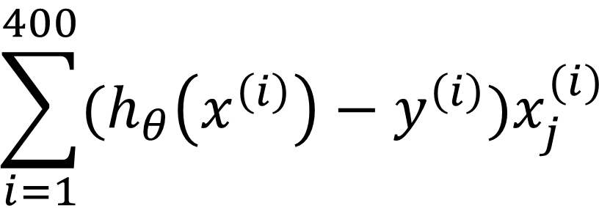
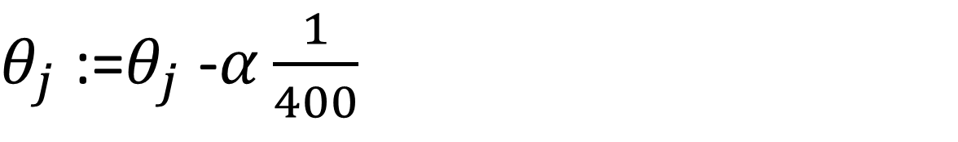
Map reduce and data parallelism
Map-reduce
Batch Gradient Descent:
$$\sum_{i=1}^{400}{(h_{θ}\left(x^{\left(i\right)}\right)−y^{\left(i\right)})x_{j}^{(i)}}$$
$θ_{j}$ :=$θ_{j}$ -$α\frac{1}{400}$

Slide 26
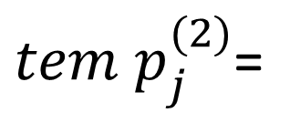
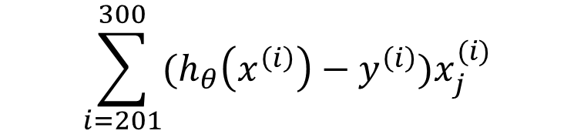
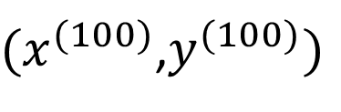
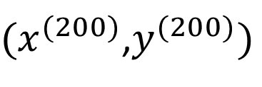
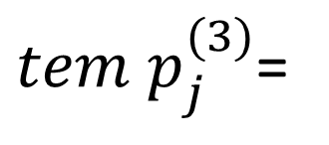
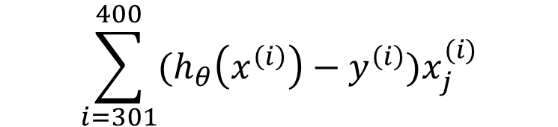
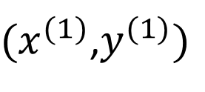
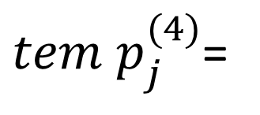
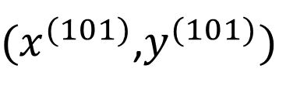
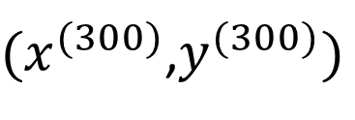






Machine1:Use( …… )
${(x}^{(1)}$,$y^{(1)})$
${(x}^{(100)}$,$y^{(100)})$
$tem p_{j}^{(1)}$=
$$\sum_{i=1}^{100}{(h_{θ}\left(x^{\left(i\right)}\right)−y^{\left(i\right)})x_{j}^{(i)}}$$
Machine2:Use( …… )
${(x}^{(101)}$,$y^{(101)})$
${(x}^{(200)}$,$y^{(200)})$
$$\sum_{i=101}^{200}{(h_{θ}\left(x^{\left(i\right)}\right)−y^{\left(i\right)})x_{j}^{(i)}}$$
$tem p_{j}^{(2)}$=
Machine3:Use( …… )
${(x}^{(201)}$,$y^{(201)})$
${(x}^{(300)}$,$y^{(300)})$
$tem p_{j}^{(3)}$=
$$\sum_{i=201}^{300}{(h_{θ}\left(x^{\left(i\right)}\right)−y^{\left(i\right)})x_{j}^{(i)}}$$
Machine4:Use( …… )
${(x}^{(301)}$,$y^{(301)})$
${(x}^{(400)}$,$y^{(400)})$
$tem p_{j}^{(4)}$=
$$\sum_{i=301}^{400}{(h_{θ}\left(x^{\left(i\right)}\right)−y^{\left(i\right)})x_{j}^{(i)}}$$

Slide 27

Map -reduce

Slide 28





Map-reduce and summation over the training set
Many learning algorithms can be expressed as computing sums of functions over the training set.
e.g. for advanced optimization, with logistic regression , need:
$$\sum_{i=1}^{m}{y^{(i)}}$$
$J_{train}$($θ)=−\frac{1}{m}$
$\log{h_{θ}}$($x^{(i)}$)-(1-$y^{(i)}$)$\log{(1−h_{θ}\left(x^{\left(i\right)}\right))}$
$$\sum_{i=1}^{m}{(h_{θ}\left(x^{\left(i\right)}\right)−y^{\left(i\right)})x_{j}^{(i)}}$$
$\frac{∂}{∂θ_{j}}J_{train}$($θ)=$

Slide 29

Multi-core machine
Mul4-­‐core machines
Core 1
Training set
Core 2
Combine results
Core 3
-­‐
Core 4

Slide 30
Thanks
Machine Perception and Interaction Group (MPIG)
www.mpig.com.cn
lx@mpig.com.cn
公众号:
mpig_robot

